Slide 1

2021 Applied Finance Project
Factor Research for U.S. Equity markets
Anatolie Chernyakhovsky, Bardia Farajnejad, Arshak Ghazaryan, Zhenhe Zhu

Slide 2
»Background and Objective
»Literature Review and Data
»Portfolio Construction Methodology
»Executive Summary
»Analysis
»Future Extensions
»Conclusion
Table of Contents

Slide 3
Background
Factor modelling has long been used to try and explain the movement of stock prices. Signals based on these factors can then be used in algorithmic trading to capture the profit profile provided by specific factor based events.
It is not only relevant to identify actionable changes in stock prices, but also the magnitude of the change in relation to the market at large. Thus, in additional to focusing on the returns generated by signals, the alpha generated is also of great interest in determining the usefulness of a signal.

Slide 4
Objectives
Test various factor-based signals to identify possible sources of excess returns and alpha
Track signals throughout the historical data to ensure usefulness and repeatability
Examine the risk-adjusted performance of signals via Sharpe and Information ratios
Create actionable and repeatable recommendations based off of findings

Slide 5
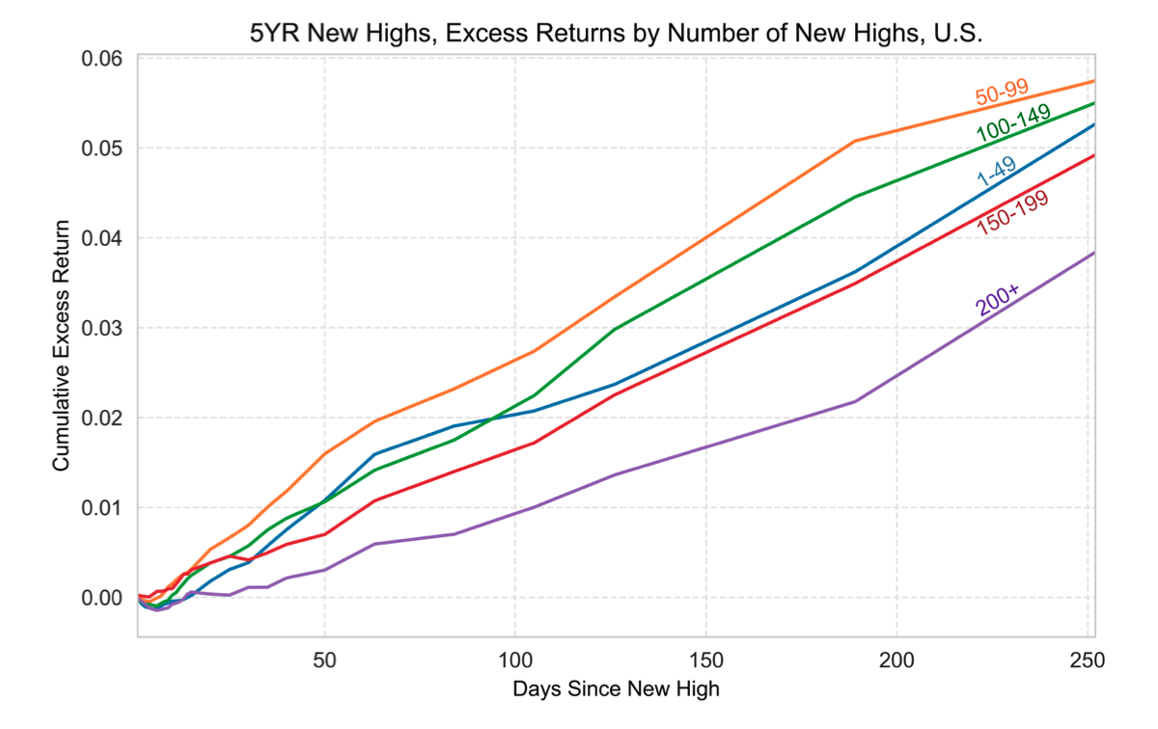
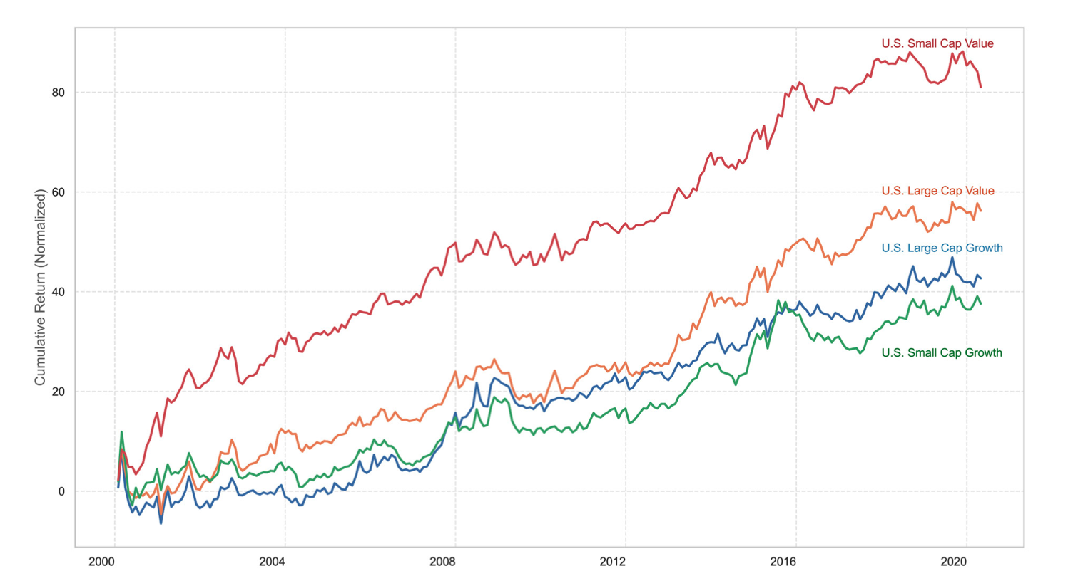
Literature Review
New Highs: Best Served Rare
Textbooks
Elements of Statistical Learning: Data Mining, Inference, and Prediction by Trevor Hastie and Robert Tibshirani
Analysis of Financial Time Series by Ruey S. Tsay
Time Series for Macroeconomics and Finance by John J. Cochrane
Whitepapers
New Highs: Segmentation by Timothy Marble and Ronald P. Ognar: Compared one year performance following a five-year new high event. Results:
Small - cap stocks’ new highs performed better than large-cap stocks’ new highs
New Highs: Best Served Rare by Timothy Marble and Ronald P. Ognar. Results:
Their research discovered that during the days when there are fewer new highs, those new highs outperform the new highs that occur during the days with many of them
RS Rating: Pharma Flameouts and Small-Cap Values by Timothy Marble and Ronald Ognar: Constructed quintile portfolios based on size and style. Results:
Small-cap value performed the best followed by large cap value
RS Rating: Pharma Flameouts and Small-Cal Values

Slide 6
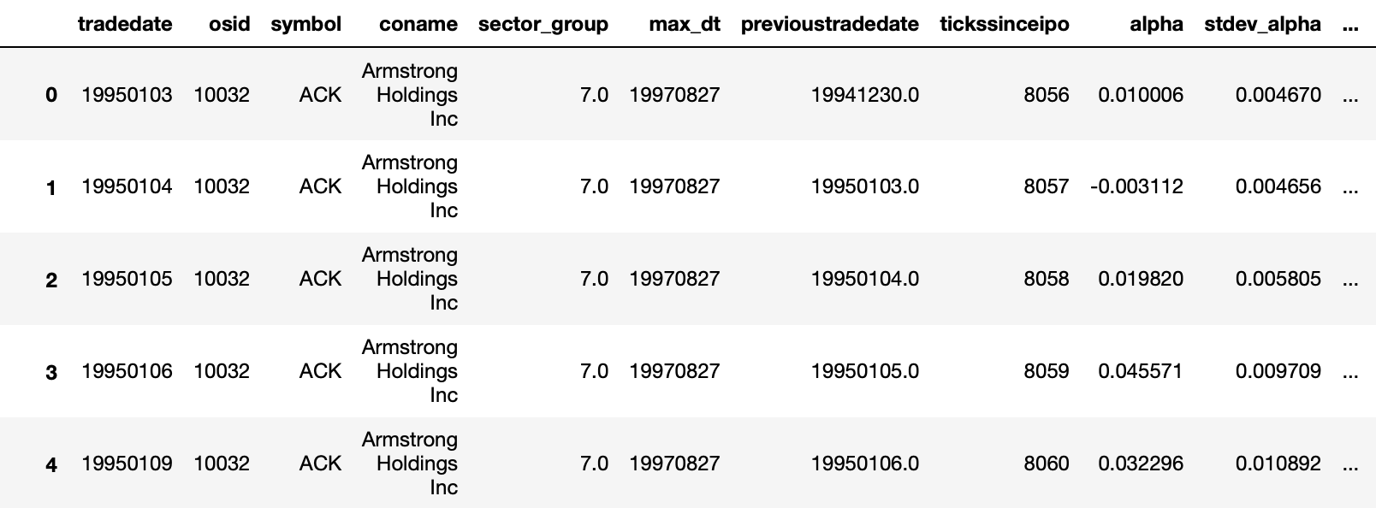
Data
A single CSV file with data on a universe of US equities (excluding very small stocks)
Every row of data represents information for one company at a trading date
Columns include data on price/volume, CAPM alpha, proprietary growth scores, analyst price targets, financial statement report/due dates, dummy indicators for index inclusions, and annual/quarterly accounting data (Earnings, Sales, and Cash Flow) as well as analyst forecasts of accounting data during a period from 1995 to 2021
Notes:
We mostly have IS and CF financial stmt variables: and analysts estimates

Slide 7
Portfolio Construction Methodology
The following steps are followed for all events tested:
Set columns ‘buy_tomorrow’/‘sell_tomorrow’ to be dummy indicators
Then, erase all ‘buy_tomorrow’ and ‘sell_tomorrow’ signals for which the change in date from ‘today’ to ‘tomorrow’ is more than 20 days
In order to simulate holding periods of 1, 5, 10, 15, and 20 days, create five dataframes with ‘buy_tomorrow’ and ‘sell_tomorrow’ signals that are pulled forward for 0, 4, 9, 14, and 19 days ahead within the same security
Make sure that step #2 is satisfied in all five dataframes from step #3
Notes:
This way, we can define discrete event based strategies… everything will have either a 1 if buy/sell, or a 0 if we don’t want to include that stock in the buy/sell portfolio the next day
erase all ‘buy_tomorrow’ and ‘sell_tomorrow’ signals for which the change in date from ‘today’ to ‘tomorrow’ is more than 20 days: if our signal says ‘buy_tomorrow’, this step just controls for the case when “tomorrow” in the dataset is like a year away

Slide 8
Portfolio Construction Methodology (cont.)
Next, we compute the following for the buy/sell signals separately in all five dataframes (1, 5, 10, 15, and 20 day holding periods):
Group stocks by date and create an equal weighted portfolio with all stocks whose signal=1 on the given day
Generate time series of returns/alphas for the equal weighted portfolios
Compute the following annualized statistics: mean return, standard deviation, SR, mean alpha, information ratio, skewness in return/alpha
Compute the time series of portfolio turnover (manually set turnover=100% when the change in date is less than 6 days)
Compute a dollar metric for transaction costs by accumulating 5bp of cost each time there is turnover in the portfolio by keeping track of starting and ending capital each period (start the portfolio with $1 of capital and 100% turnover)
Regress our excess returns on FF5 + Momentum factors
Notes:
We do this for all 5 dataframes so that we simulate holding periods of 1,5,10,15,20 days when a signal occurs
Count the number of buys/sells in each date (set=N) and then set the weight of a single security on that date = 1/N
Get equal weighted return (RET_NEXT_DAY*w) daily
Get summary stats from return series: THESE ARE NOT NET OF T-COST
Get turnover from using starting weights and ending weights [end weight = (starting weights * return) / sum of ending weights]
Start with $1, invest 0.9995 cents (starting capital after t-cost), set ending capital=ew_returns*0.9995, multiply ending capital*5bp*turnover to get ending capital after T-cost
Regress our excess returns on FF5 + Momentum factors to get factor exposures
LASTLY, plot cum return net of T-cost… The backtest is intended to be realistic due to the inclusion of transaction costs.

Slide 9
Executive Summary
Signal Name | Average N-Period Return | Standard Deviation | Sharpe Ratio | Information Ratio
High EPS relative to current EPS (Long/Short) - 5 Day | 29.02% 23.39% | 27.64% 29.91% | 1.05 0.78 | 0.36 -0.01
Strong Alpha Deviation (Long/Short) - 5 Day | 39.52% 27.98% | 27.87% 25.86% | 1.42 1.08 | 0.84 0.21
Price Target Moves (Long/Short) - 5 Day | 38.31% -3.30% | 25.30% 27.35% | 1.51 -0.12 | 2.01 -1.60
Unusual Volume (Long/Short) - 1 Day | 78.13% 16.86% | 150.9% 25.54% | 0.52 0.66 | 1.39 -0.35
Momentum + Earnings Surprise (Long/Short) - 10 Day | 35.11% 18.52% | 40.85% 46.39% | 0.86 0.40 | 0.53 -0.01
Index Inclusion/Removal (Long/Short) - 20 Day | 75.03% 4.38% | 69.76% 47.59% | 1.08 0.09 | 0.69 -0.50
EPS High Moves (Long/Short) - 5 Day | 45.68% 14.17% | 27.03% 26.67% | 1.69 0.53 | 1.51 -0.43
2F CAPM - 10 Day | 5.36% | 4.88% | 1.05 | 1.68
Stock split - 20 Day | 38.95% | 44% | 0.27 | 0.89
Change in sector group - 20 Day | 43.25% | 38.66% | 1.17 | 0.9

Slide 10
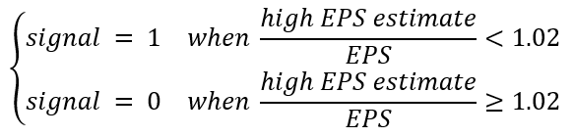
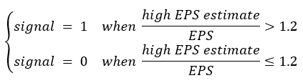
LONG/SHORT Signal: High EPS Estimate Relative to Current EPS 5 Day Horizon
Hypothesis/Intuition: When current EPS is close to the higher end of analyst EPS estimates, it provides a positive outlook on the stock’s performance and should drive excitement in the stock. Could also be due to the overreaction to new private data and underreaction to new public data.
Define Buy event: (Occurrences of Buys in Data: 285,935 times across 6,546 trading days)
Define Sell event: (Occurrences of Sells in Data: 308,410 times across 6,440 trading days)
Notes:
Investors overreact to new private info and underreact to new public info
Investors also overreact to extreme info on exciting stocks (when High EPS estimate is 20% or more larger than EPS)
Investors underreact to boring stocks that do not have extreme information (when High EPS estimate only 2% or less larger than EPS)

Slide 11
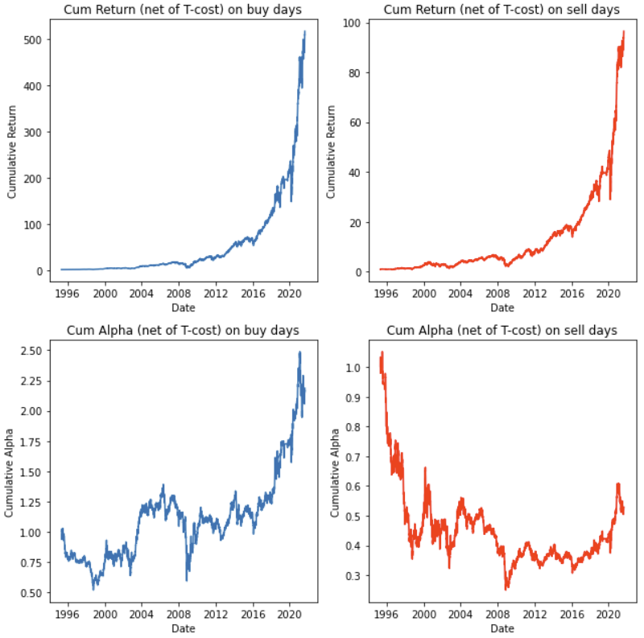
LONG/BUY Signal: High EPS estimate exceeds EPS by more than 20%
Annualized Metrics | Buy | Sell
Mean Return | 29.02% | 23.39%
Volatility | 27.64% | 29.91%
Sharpe Ratio | 1.05 | 0.78
Skewness of Returns | -0.13 | 0.09
Mean Alpha | 5.19% | -0.14%
Tracking Error | 14.49% | 16.26%
Info. Ratio | 0.36 | -0.01
Average Turnover | 0.04 | 0.04
Factor Exposure | Coefficient / (T-Stat) Buy | Coefficient / (T-Stat) Sell
SMB | 0.1175 (3.242) | 0.0800 (2.031)
CMA | -0.1660 (-2.698) | -0.1571 (-2.346)
MOM | 0.1572 (1.965) | 0.1407 (1.615)

Slide 12
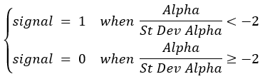
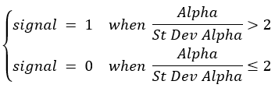
LONG/BUY Signal: Day Alpha is more than 2 Standard Deviations from 0 5 Day Horizon
Hypothesis/Intuition: Overreaction to a signal in the market is not uncommon. This is usually immediately followed by some from of correct in the opposite direction. By using alpha to measure stock performance, we can put any drops in stock values into context within general market trends.
Define Buy event: (Occurrences of Buys in Data: 120,396 times across 6,712 trading days)
Define Sell event: (Occurrences of Sells in Data: 137,208 times across 6,715 trading days)

Slide 13
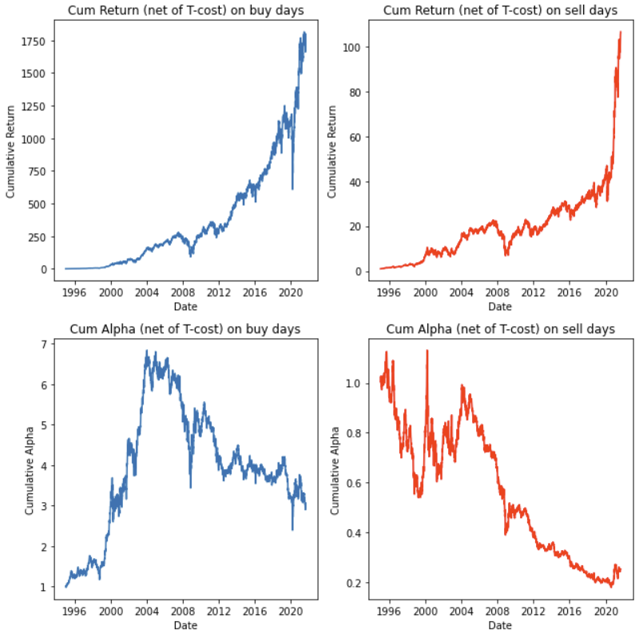
LONG/BUY Signal: Day Alpha is more than 2 Standard Deviations below 0
Annualized Metrics | Buy | Sell
Mean Return | 39.52% | 27.98%
Volatility | 27.87% | 25.86%
Sharpe Ratio | 1.42 | 1.08
Skewness of Returns | 0.15 | 0.01
Mean Alpha | 12.78% | 2.85%
Tracking Error | 15.16% | 13.65%
Info. Ratio | 0.84 | 0.21
Average Turnover | 0.30 | 0.28
Factor Exposure | Coefficient / (T-Stat) Buy | Coefficient / (T-Stat) Sell
Beta | -0.0465 (-2.345) | -0.0435 (-2.366)
SMB | 0.0948 (2.615) | 0.0849 (2.524)
CMA | -0.1942 (-3.147) | -0.1607 (-2.807)

Slide 14
LONG/SHORT Signal: Price Target Moves
Hypothesis: Changes in price target may come from changes in underlying fundamentals or from analysts’ job security concerns. Investors may underreact to this information, and thus the stock may drift in one way for some time.
Define Buy event: (Occurrences of Buys in Data: 3,891 times across 2,161 trading days
Define Sell event: (Occurrences of Sells in Data: 2,207 times across 1,444 trading days
Notes:
Price Target mean, median, high, low did work, but profits were not as large as when we used (O’Neil’s proprietary) the “price target” estimates
Now do the same event but incorporate the SD of price target:
for increases (in price target) that are > 1 SD of price target → buy
for decreases (in price target) that are > 1 SD of price target → sell

Slide 15
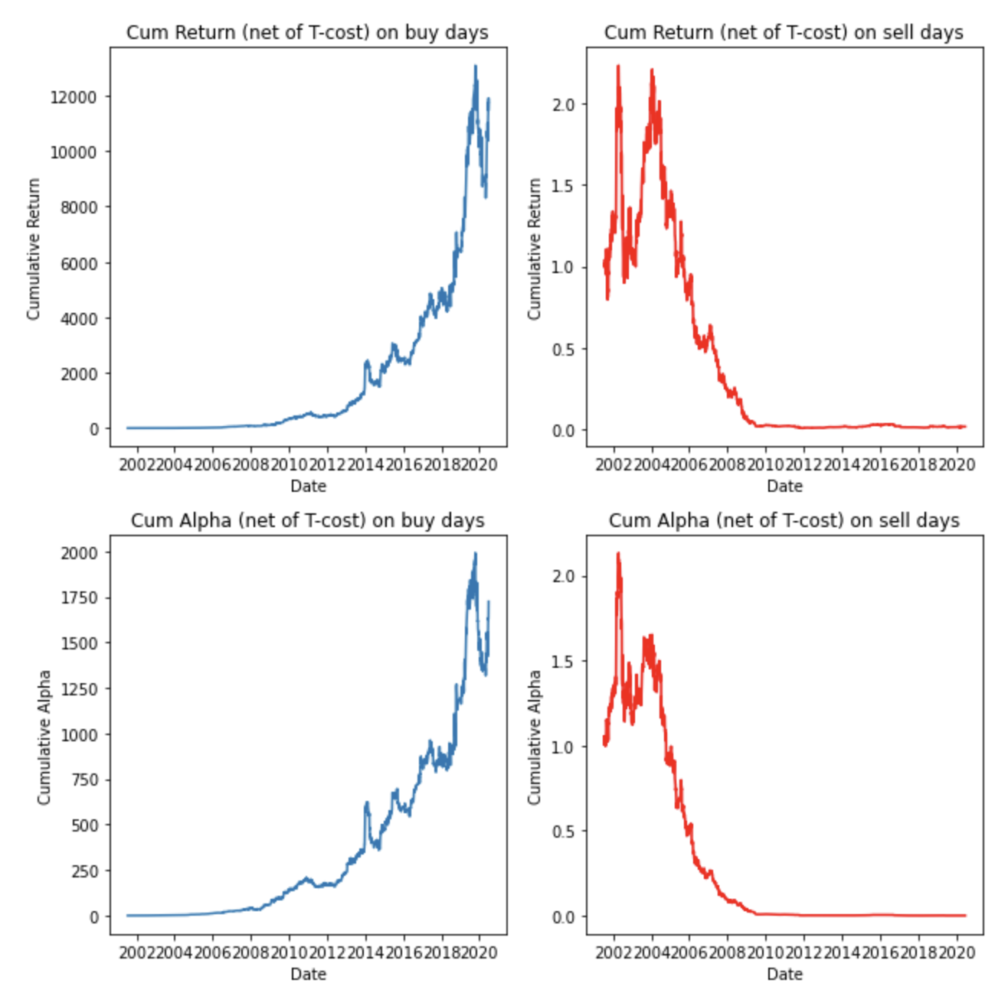
LONG/SHORT Signal: Price Target Moves
Annualized Metrics | Buy | Sell
Mean Return | 74.34% | -8.87%
Volatility | 35.48% | 47.93%
Sharpe Ratio | 2.09 | -0.19
Skewness of Returns | 2.05 | -1.34
Mean Alpha | 59.85% | -28.88%
Tracking Error | 28.22% | 41.12%
Info. Ratio | 2.12 | -0.70
Average Turnover | 0.35 | 0.35
Factor Exposure | Coefficient / (T-Stat) Buy | Coefficient / (T-Stat) Sell
Beta | -0.04 (-1.15) | -0.10 (-2.32)
SMB | 0.04 (0.53) | 0.32 (3.63)
HML | -0.18 (-2.71) | -0.02 (-0.27)
Intercept | 0.0024 (4.01) | -0.0007 (-0.83)
Notes:
On the left, it is the strategy holding for 1 day: profits are 10x higher than before, although IR is slighly lower than b4 (still above 4 IR tho)
On the right, it is the same strategy holding for 5 day → profits are 4x higher than b4, the spread gets much smaller but it still exists
Returns, alphas, SR and IR fall monotonically as you hold for longer than 5 days → 10, 15, and 20 days
Sell portfolio starts to make a little money (cum ret net of T-cost>2.5-8.0, but still no alpha) if hold for 15-20 days
Investors underreact EVEN MORE THAN B4, thus creating profitable strategies, even when holding for 5-10 days
→ It pays to incorporate the SD of price target into the strategy and define the event as such!
→ If there is a lot of disagreement among analyst and price target does not move by much → don’t trade
→ If there is a lot of disagreement among analyst and price target moves by A LOT → trade
Investors underreact even more to (relatively LARGE) changes in price targets

Slide 16
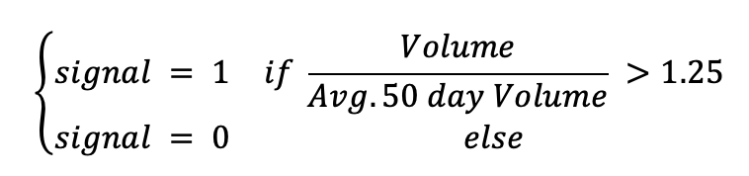
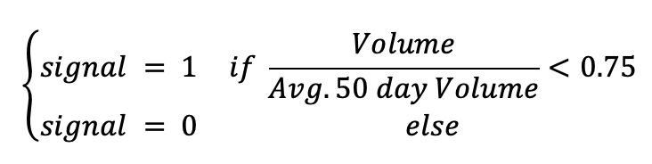
LONG/SHORT Signal: Unusual Volume
Hypothesis: When shorting is costly or not allowed, high trading volume means optimism and overvaluation, leading to high returns in the short run and low returns in the long run.
Define Buy event: (Occurrences of Buys in Data: 652,294 times across 6,712 trading days
Define Sell event: (Occurrences of Sells in Data: 1,206,341 times across 6,715 trading days

Slide 17
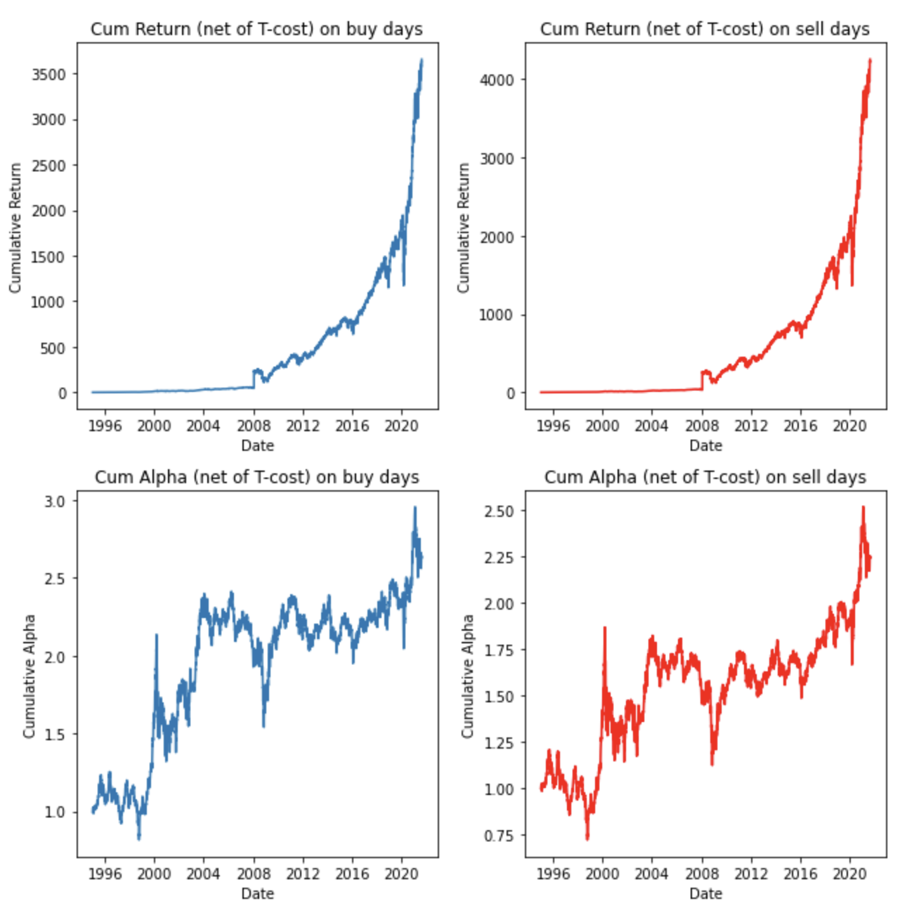
LONG/SHORT Signal: Unusual Volume
Annualized Metrics | Buy | Sell
Mean Return | 44.39% | 53.70%
Volatility | 79.81% | 135.74%
Sharpe Ratio | 0.56 | 0.40
Skewness of Returns | 69.79 | 77.69
Mean Alpha | 6.01% | 4.77%
Tracking Error | 11.88% | 11.81%
Info. Ratio | 0.51 | 0.40
Average Turnover | 0.07 | 0.04
Factor Exposure | Coefficient / (T-Stat) Buy | Coefficient / (T-Stat) Sell
SMB | 0.25 (2.35) | 0.37 (2.07)
Notes:
On the left, it is the strategy holding for 1 day: profits are large, spread between profits of the 2 portfolios is large (IR is larger although the SR is slightly lower)
On the right, it is the same strategy holding for 10 days → profits begin to disappear (5 day→ profits are still there although much smaller spread)
Sell portfolio starts to do very similar to buy portfolio at longer horizons up to 20 days (can also incorporate 5 day avg volume vs 50 day avg volume as well… seems like 1 day volume is very ST signal)
Idea is: shorting is costly or not allowed, so when there is high trading volume, it implies that there is a lot of optimism and overvaluation leading to high returns in the short run (which is evident in the profits we make from 1 day holding period)
leading to low returns in the short run → will need a different measure (say 5 day vs 20 day volume and may need to hold for 20 days to see the effect)

Slide 18
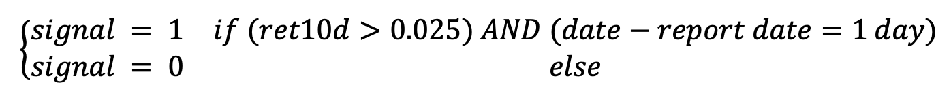
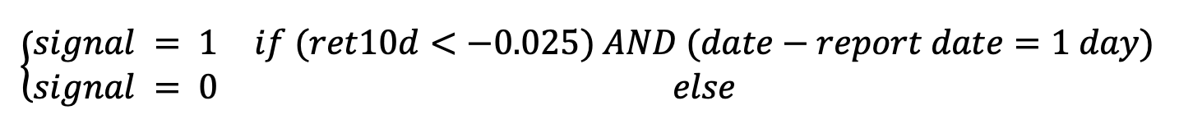
LONG/SHORT Signal: Momentum on report date
Hypothesis: Sophisticated investors anticipate a company’s report date surprises in advance. The trend will continue in the future after earnings are reported because investors underreact to the news.
Define Buy event: (Occurrences of Buys in Data: 19,466 times across 3,494 trading days
Define Sell event: (Occurrences of Sells in Data: 13,471 times across 3,048 trading days

Slide 19
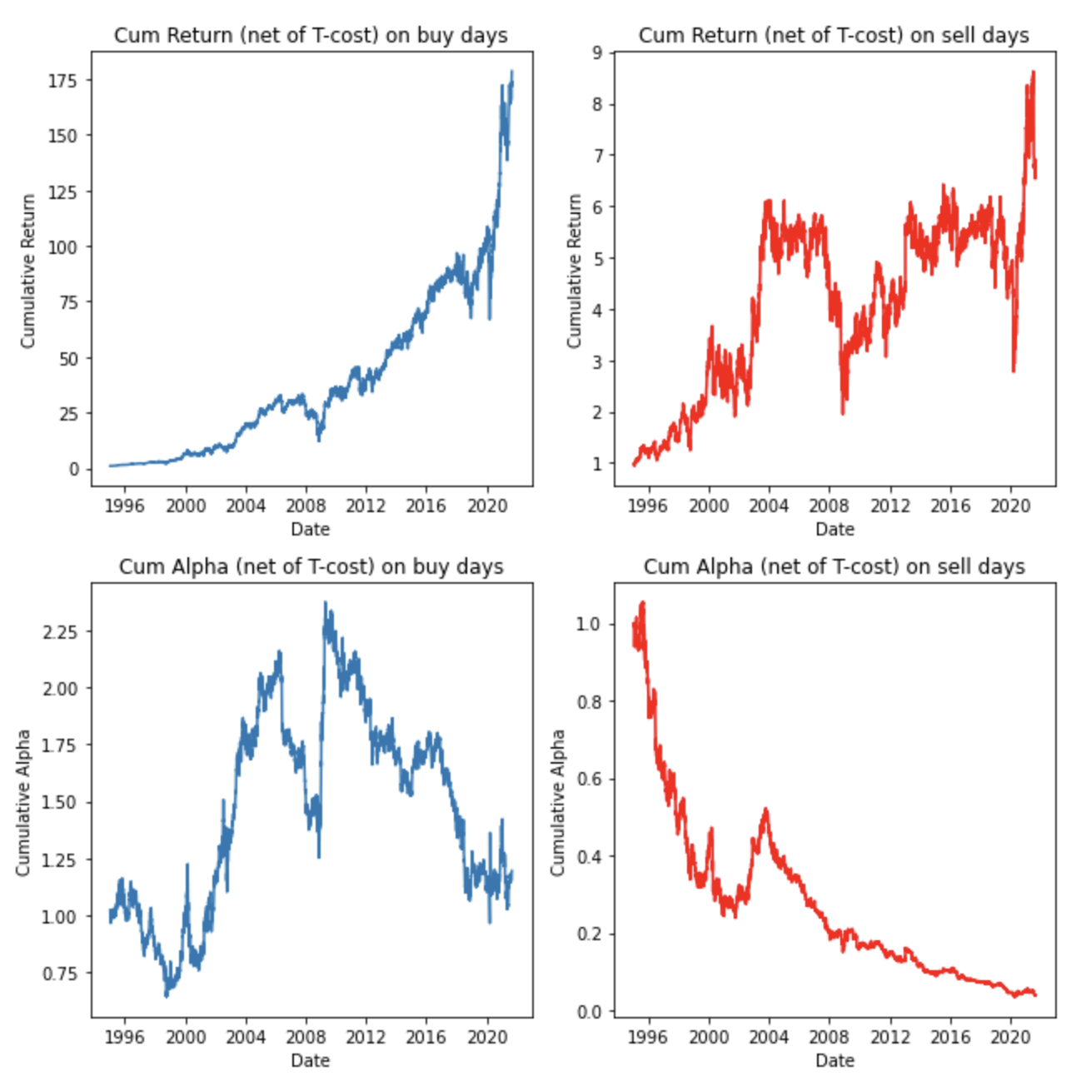
LONG/SHORT Signal: Momentum on report date
Annualized Metrics | Buy | Sell
Mean Return | 28.34% | 16.89%
Volatility | 26.93% | 29.78%
Sharpe Ratio | 1.05 | 0.57
Skewness of Returns | 0.22 | 0.26
Mean Alpha | 6.90% | -5.60%
Tracking Error | 16.36% | 19.06%
Info. Ratio | 0.42 | -0.29
Average Turnover | 0.19 | 0.20
Factor Exposure | Coefficient / (T-Stat) Buy | Coefficient / (T-Stat) Sell
SMB | 0.04 (1.10) | 0.12 (2.92)
CMA | -0.23 (-3.75) | -0.23 (-3.39)
MOM | 0.26 (3.39) | 0.20 (2.32)
Notes:
1-5 day holding period → no profits
On the left, it is the strategy holding for 10 day: profits are large, spread between profits of the 2 portfolios is large (risk adjusted as well)
On the right, it is the same strategy holding for 15 days → profits get larger (higher risk adjusted profits as well)
20 day holding period also performs well, but spread gets smaller as short portfolio performs well in 2020 and rapidly spikes up to $40 from being at about $10
Also, IF both earnings report due portfolios do well (both buy and sell) —> bcuz volume increases during earnings announcements and expect increase in price around that time.

Slide 20
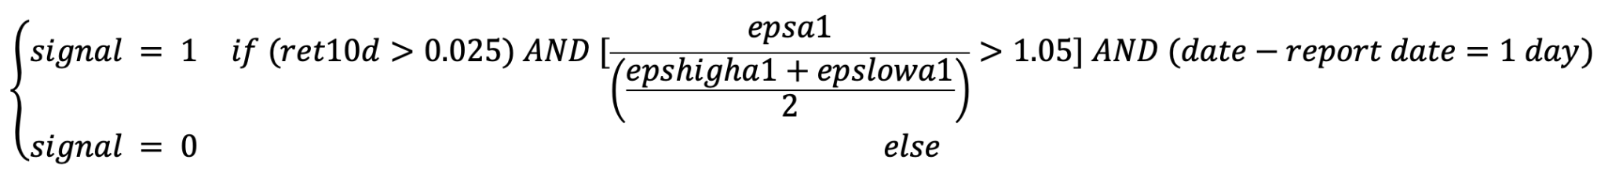
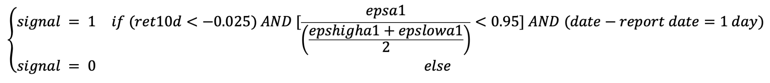
LONG/SHORT Signal: Momentum + Earnings Surprise on report date
Hypothesis: Sophisticated investors anticipate a company’s report date surprises in advance. If this anticipation is met with a “same side surprise”, then the trend will continue in the future as investors underreact to earnings.
Define Buy event: (Occurrences of Buys in Data: 1,100 times across 771 trading days
Define Sell event: (Occurrences of Sells in Data: 975 times across 694 trading days

Slide 21
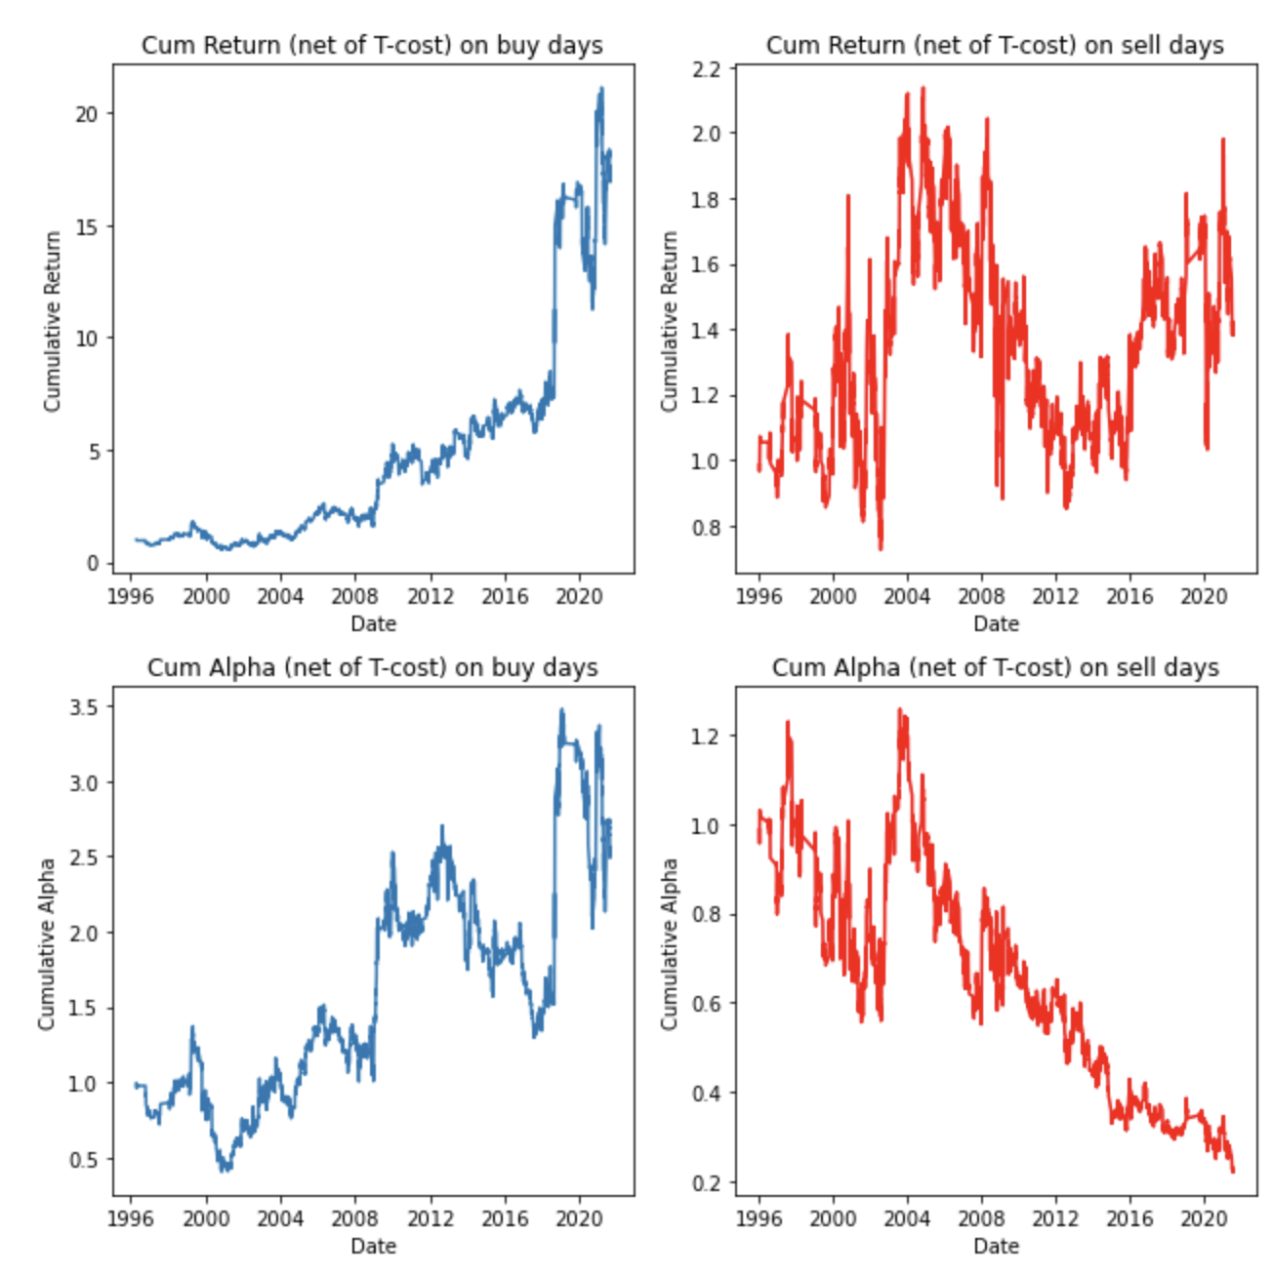
LONG/SHORT Signal: Momentum + Earnings Surprise on report date
Annualized Metrics | Buy | Sell
Mean Return | 35.11% | 18.52%
Volatility | 40.85% | 46.39%
Sharpe Ratio | 0.86 | 0.40
Skewness of Returns | 0.75 | 0.87
Mean Alpha | 17.81% | -0.25%
Tracking Error | 33.29% | 36.36%
Info. Ratio | 0.53 | -0.01
Average Turnover | 0.21 | 0.21
Factor Exposure | Coefficient / (T-Stat) Buy | Coefficient / (T-Stat) Sell
SMB | 0.04 (0.49) | 0.20 (2.36)
MOM | 0.41 (2.53) | -0.02 (-0.08)
Notes:
1-5 day holding period → no profits
On the left, it is the strategy holding for 10 day: profits are large, spread between profits of the 2 portfolios is 10x as large (risk adjusted as well)
On the right, it is the same strategy holding for 20 days → spread gets larger in magnitude but smaller relatively (lower relative risk adjusted performance)
15 day holding period also performs well, but relative spread gets smaller as short portfolio 5x better than 10 day holding period and gets to $10 in profits and long portfolio only does 2x better than 10 day holding period and gets to $40 in profits
Also, IF both earnings report due portfolios do well (both buy and sell) —> bcuz volume increases during earnings announcements and expect increase in price around that time.

Slide 22
LONG/SHORT Signal: Index Inclusion and Removal
Hypothesis: Investors overreact to a stock’s index inclusion and removal ahead of the event. When the event occurs, the stock is mispriced such that future returns become lower for stocks being included and higher for stocks being removed.
Define Buy event: (Occurrences of Buys in Data: 232 times across 147 trading days
Define Sell event: (Occurrences of Sells in Data: 439 times across 286 trading days

Slide 23
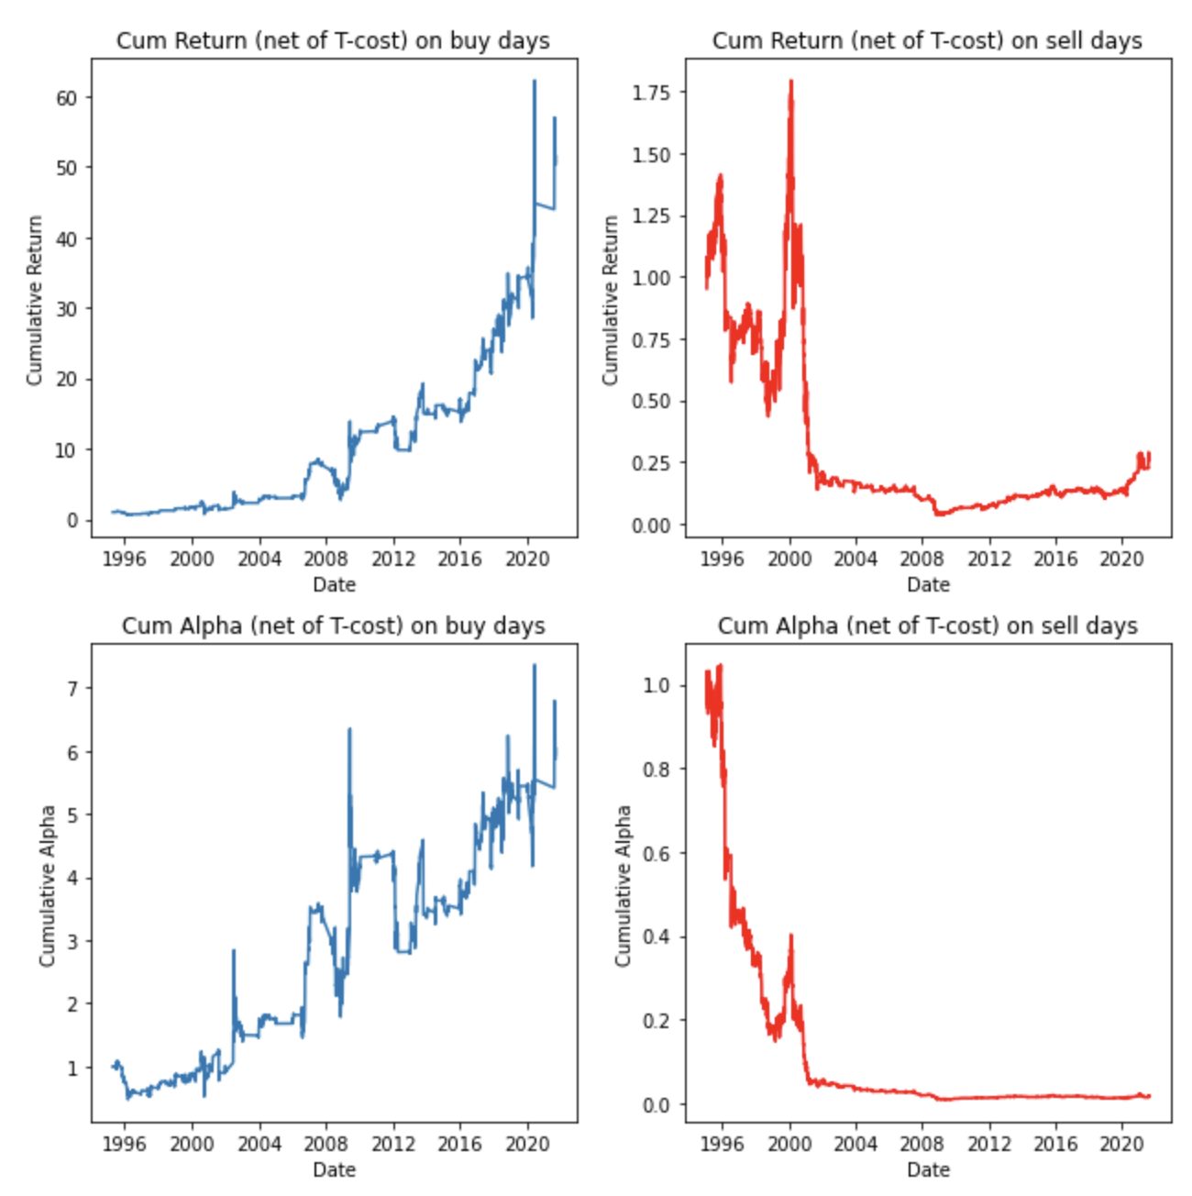
LONG/SHORT Signal: Index Inclusion and Removal
Annualized Metrics | Buy | Sell
Mean Return | 75.03% | 4.38%
Volatility | 69.76% | 47.59%
Sharpe Ratio | 1.08 | 0.09
Skewness of Returns | 0.77 | 0.06
Mean Alpha | 41.74% | -19.18%
Tracking Error | 60.33% | 38.03%
Info. Ratio | 0.69 | -0.50
Average Turnover | 0.08 | 0.09
Notes:
1-5 day holding period → no profits
On the left, it is the strategy holding for 10 day:
In the middle, it is the same strategy holding for 15 days → profits 2x
On the right, it is the same strategy holding for 20 days → profits 2x

Slide 24
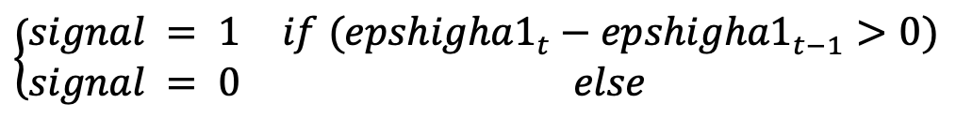
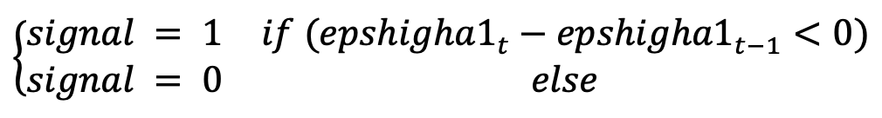
LONG/SHORT Signal: 1 Year EPS High Forecast Moves
Hypothesis: Changes in analyst forecast may come from changes in underlying fundamentals or from analysts’ job security concerns. Investors may underreact to this information, and thus the stock may drift in one way for some time.
Define Buy event: (Occurrences of Buys in Data: 37,027 times across 5,916 trading days
Define Sell event: (Occurrences of Sells in Data: 41,421 times across 6,103 trading days

Slide 25
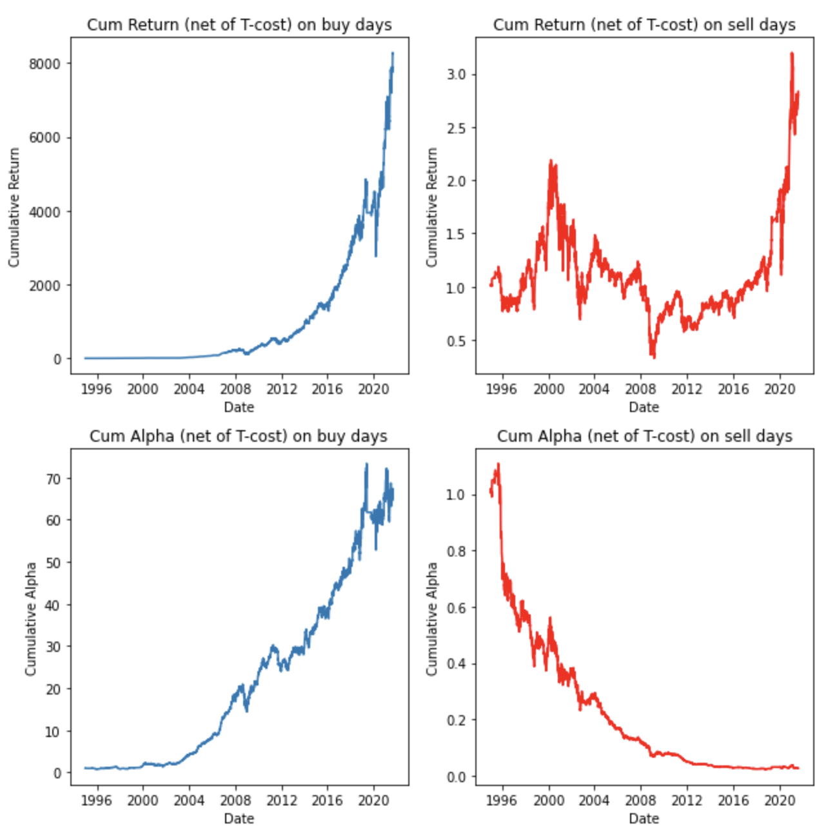
LONG/SHORT Signal: 1 Year High EPS Forecast Moves
Annualized Metrics | Buy | Sell
Mean Return | 45.68% | 14.17%
Volatility | 27.03% | 26.67%
Sharpe Ratio | 1.69 | 0.53
Skewness of Returns | 0.07 | 0.06
Mean Alpha | 24.58% | -6.58%
Tracking Error | 16.24% | 15.27%
Info. Ratio | 1.51 | -0.43
Average Turnover | 0.28 | 0.26
Factor Exposure | Coefficient / (T-Stat) Buy | Coefficient / (T-Stat) Sell
SMB | 0.03 (0.90) | 0.08 (2.28)
CMA | -0.10 (-1.67) | -0.13 (-2.23)
MOM | 0.19 (2.39) | 0.11 (1.43)
Intercept | 0.001 (2.94) | 0.000 (0.24)
Notes:
On the left, it is the strategy holding for 1 day: makes $250m
On the right, it is the same strategy holding for 5 day → the spread gets much smaller but it still exists
Monotonically perform worse and worse as you hold for longer than 5 days → 10, 15, and 20 days
EPS low moves not as informative and profitable as this strategy! But still works
Also, EPS 2-4 year does not work well --> think: investors anchor exp, no gains in ST. Also, stat arb week 5 has lots of alphas that can use... create notes that takes into account these alphas

Slide 26
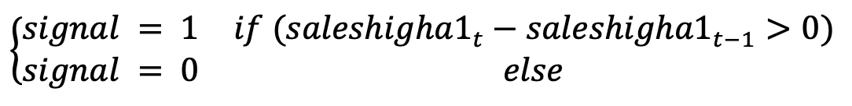
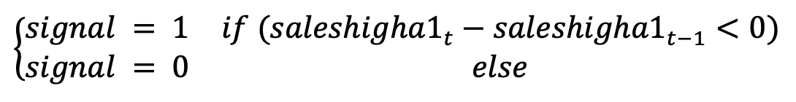
LONG/SHORT Signal: 1 Year Sales High Forecast Moves
Hypothesis: Changes in analyst forecast may come from changes in underlying fundamentals or from analysts’ job security concerns. Investors may underreact to this information, and thus the stock may drift in one way for some time.
Define Buy event: (Occurrences of Buys in Data: 34,369 times across 5,589 trading days
Define Sell event: (Occurrences of Sells in Data: 39,312 times across 5,918 trading days

Slide 27
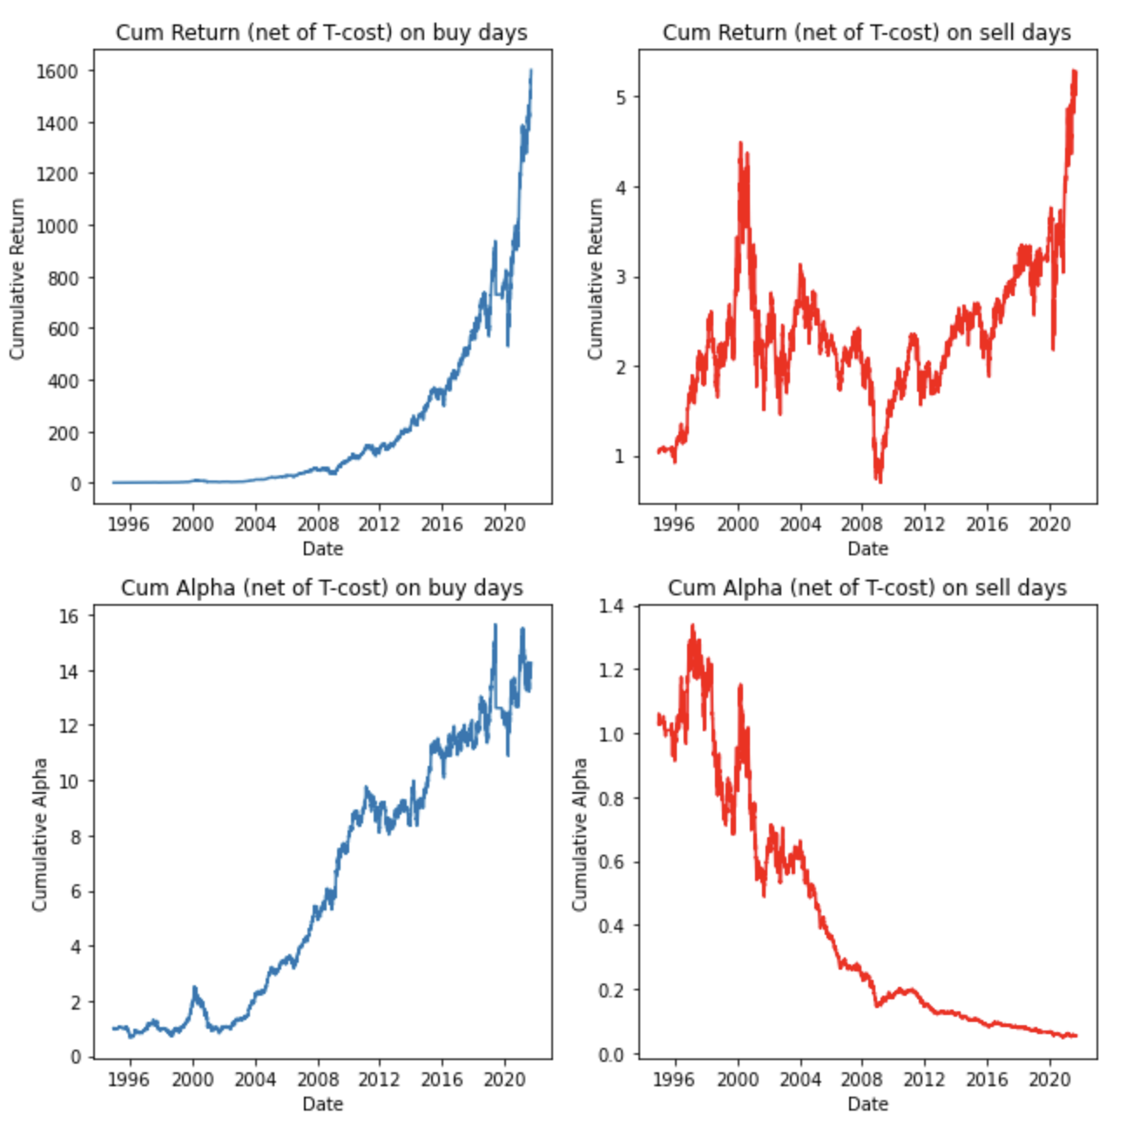
LONG/SHORT Signal: 1 Year High Sales Forecast Moves
Annualized Metrics | Buy | Sell
Mean Return | 40.70% | 17.17%
Volatility | 29.74% | 27.98%
Sharpe Ratio | 1.37 | 0.61
Skewness of Returns | -0.36 | -0.-0.03
Mean Alpha | 19.50% | -3.55%
Tracking Error | 19.66% | 16.88%
Info. Ratio | 0.99 | -0.21
Average Turnover | 0.28 | 0.26
Factor Exposure | Coefficient / (T-Stat) Buy | Coefficient / (T-Stat) Sell
Beta | -0.05 (-2.26) | -0.02 (-0.98)
SMB | 0.09 (2.28) | 0.08 (2.15)
CMA | -0.19 (-2.86) | -0.10 (-1.51)
MOM | 0.18 (2.09) | 0.13 (1.55)
Notes:
On the left, it is the strategy holding for 1 day: $20m in profits
On the right, it is the same strategy holding for 5 day → the spread gets much smaller but it still exists:
Monotonically perform worse and worse as you hold for longer than 5 days → 10, 15, and 20 days
Sales low moves not as informative and profitable as this strategy! But still works
Also, Sales 2-4 year does not work well --> think: investors anchor exp, no gains in ST. Also, stat arb week 5 has lots of alphas that can use... create notes that takes into account these alphas

Slide 28

Signal: Stock Split
Hypothesis: Many companies announce stock splits so that the share price for a stock remains affordable for retail investors. This can be viewed as a positive sign since the stock price increased to a point where the shares need to be split for them to be affordable. Therefore, we would like to test whether a stock split would be a bullish signal. For the stocks that announce stock splits, we will buy them the next day after the announcement and see how that strategy performs.
Signal Defined as: (955 occurrences)

Slide 29
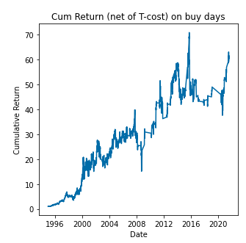
Results: Stock Split
Annualized Metrics | 20-Day Holding Period
Mean Return | 38.95%
Volatility | 44%
Sharpe Ratio | 0.89
Skewness of Returns | 0.19
Mean Alpha | 9.75%
Tracking Error | 35.51%
Info. Ratio | 0.27
Average Turnover | 0.11
Factor Exposure | Coefficient / (T-Stat)
Beta | 0.088 (1.98)
RMW | 0.234 (2.34)
CMA | -0.363 (-2.88)

Slide 30
Signal: Change in sector group of a company
Hypothesis: Some companies that are experiencing financial hardship and are close to bankruptcy decide to pivot and change the direction where they are headed. Sometimes when they do that, they decide to pursue a different industry. This would result in the change of their sector group. Therefore, it is possible to expect the market to buy the stock since this event sparks the possibility of the company becoming profitable again. We would like to test whether this event could be used as a signal. For the companies that change their sector groups, we will purchase their stock one day after the change in the sector group and test how that strategy performs.
Signal Defined as: (406 occurrences)

Slide 31
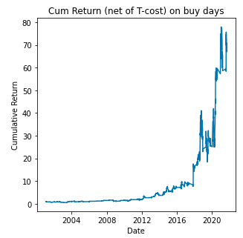
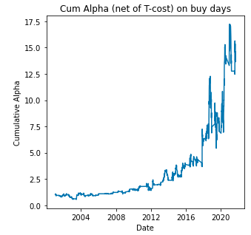
Signal: Change in sector group of a company
Annualized Metrics | 20-Day Holding Period
Mean Return | 65.74%
Volatility | 56.03%
Sharpe Ratio | 1.17
Skewness of Returns | 2.28
Mean Alpha | 44.33%
Tracking Error | 49.44%
Info. Ratio | 0.90
Average Turnover | 0.09
Factor Exposure | Coefficient / (T-Stat)
SMB | 0.23 (1.89)

Slide 32
Future Extensions
Portfolios without assuming fractional shares
Different weighting structures
Potentially testing risk-parity portfolios
Implementing Beta-neutrality hedging
Combining signals with statistically significant positive Value and Momentum exposures into one factor
Test events based on Balance Sheet data & Balance Sheet Analyst estimates
Restrict regressors to only FF3+MOM
Notes:
5. Corr(Value, MOM) < 0 → may improve SR if we combine signals that have high exposure to value to signals that have exposure to momentum
6. We did FF5+MOM… may get different numbers for our intercept/Beta’s in our regression if we only regress on FF3+MOM

Slide 33
Questions?
Notes:
Thank you so much to Prof Herskovic, not only we took a lot of the stuff we learned about QAM from his class and applied similar thinking throughout this project, but we are grateful for his help throughout the project as well and giving us pointers on how to make the work better

